Slide 1
SRA Key Topics
Reference Architectures for
Cyber-Physical Systems
Dr. Christian El Salloum
AVL List GmbH

Slide 2
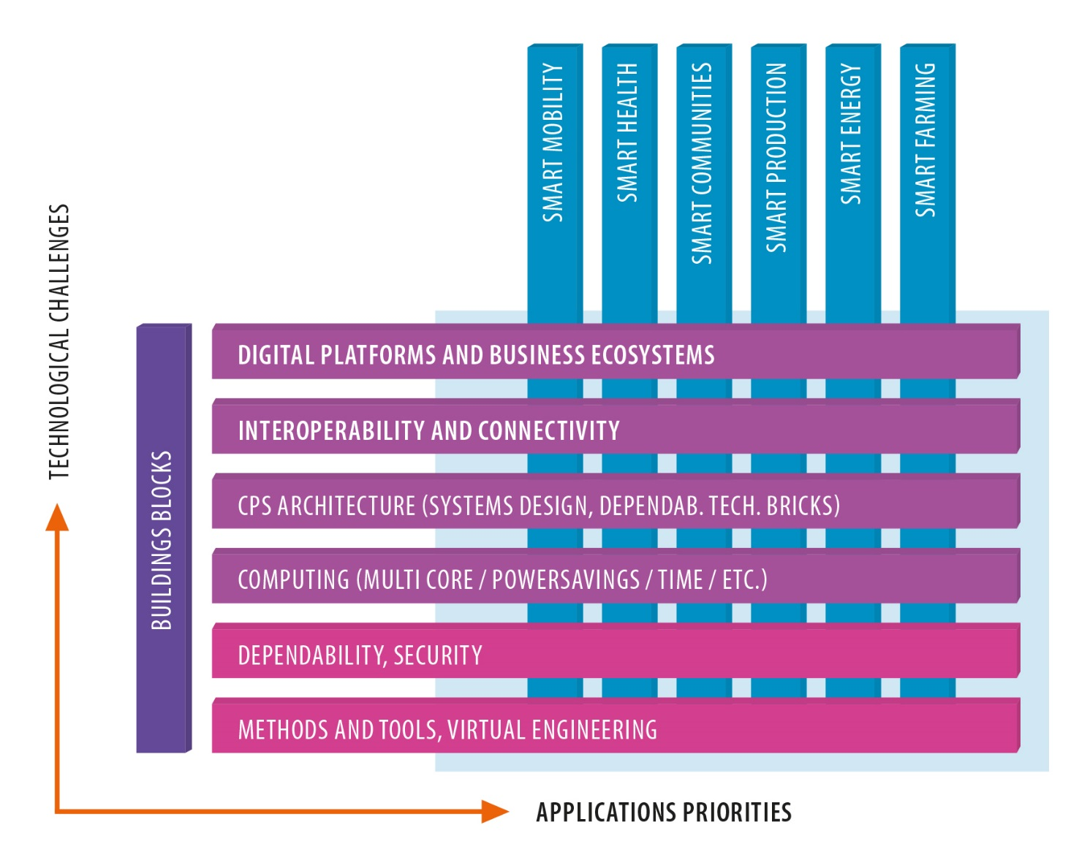
SRA Matrix

Slide 3
Complexity as the major driver
Increasing openness and interconnection while retaining security and safety properties (e.g., connected car)
Enabling certification in highly complex and non-deterministic environments
Heterogeneous communication infrastructures and requirements
On-line evolution of large real-time systems
Cooperation in the entire product life-cycle
…
→ It would be futile to tackle the complexity challenge with a pure bottom-up approach!

Slide 4
Major features of a reference architecture
Separation of concerns
Generic and common topics are handled by the architecture/platform
Engineers can concentrate on solving their truly application-related problem
Provision of common services required by most of the applications
Security and access rights management
Communication and storage
Registration and discovery
Monitoring and maintenance
Fault tolerance
Deployment (e.g., update-over-the-air)

Slide 5
Major features of a reference architecture (cont’d)
Support efficient reuse and composability
Enable product creation by composing pre-validated building blocks from a library
Specific challenges: real-time behavior, fault tolerance and security
Dependability by design
Enforce architectural principles that lead to dependable products
Establish a (de-facto) standard
Provide open interfaces, follow existing standards, provide development kits, good documentation, ecosystems

Slide 6
Research Challenges System and System-of-Systems (SoS) - Level
Architectures and platforms that provide holistic solutions to satisfy the (sometimes contradicting) requirements for fault tolerance, real-time emergent behavior, security and openness
Wireless techniques and protocols for real-time control
Enable interaction of hard real-time CPS with services in the Cloud
Enable Self-Maintenance
Enable independent validation and certification of individual CPS that are part of a larger System-of-Systems
…

Slide 7
Research Challenges Multi/many-core systems / System-on-a chip/ Network-on-a-chip
Multi-core and SoC architectures have been extremely successful in the consumer, desktop and high-performance market
For safety-critical, real-time CPS important challenges have to be solved:
Enable devices with low energy footprints
Support guaranteed real-time behavior in a multi-core context
Enable certification of highly complex and performant multi-core SoCs
…

Slide 8
Thank you for your attention
Dr. Christian El Salloum (AVL List GmbH)
christian.elsalloum@avl.com

