Slide 1
ARTEMIS Industry Association
Jan Lohstroh
Secretary General, ARTEMIS Industry Association
April 2016

Slide 2
ARTEMIS Industry Association is a membership organization with more than 170 members and associates from all over Europe. The multidisciplinary nature of the membership provides an excellent network for the exchange of technology ideas, cross-domain fertilisation, as well as for large innovation initiatives.

Slide 3
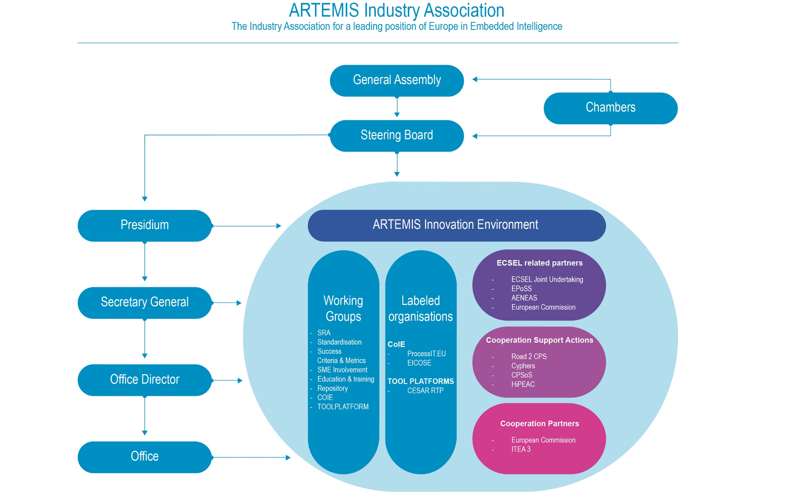

Slide 4
ARTEMIS Industry Association
Mission
ARTEMIS Industry Association nurtures the ambition to strengthen Europe's position in Embedded Intelligence and to attain world-class leadership in this domain to support the European Industry.
Objectives
Represent Industry in the best way possible and explain to policymakers the need of research and funding in Embedded Intelligence.
Be a European Technology Platform (ETP) in Embedded Intelligence
To be one of the private partners of ECSEL Joint Undertaking

Slide 5
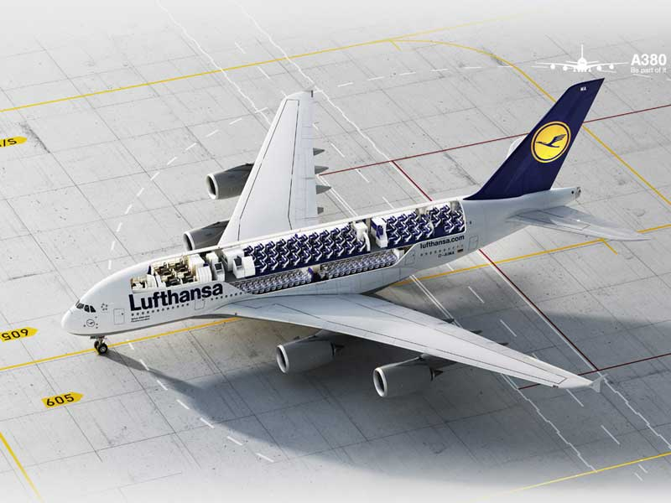







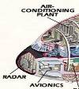


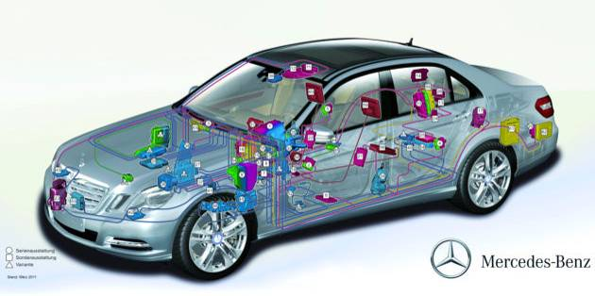
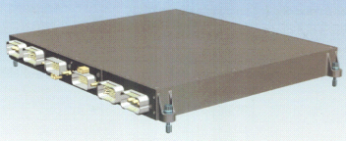
Embedded Intelligence
Embedded & Cyber-Physical Systems
1
Increase of electronic systems, especially
as Embedded Systems, is required for:
mastering complexity
meeting environmental challenges
competitiveness
cost efficiency
This impact will even increase !

Slide 6



ARTEMIS-IA Focus Areas
ARTEMIS Industry Association is the association
for actors in Embedded Intelligent Systems within Europe.
ARTEMIS Industry Association has 3 main focus areas in Embedded Intelligence:
Embedded & Cyber-Physical Systems
Internet of Things
Digital Platforms

Slide 7
Embedded CPS?
Cyber Physical Systems not (well) understood by the public and politicians
  NOT related to Cyberspace
  NOT related to Cybercrime
  Related to Cybernetics, a term coined by Norbert Wiener in 1942
    Wiener derived the term from the Greek κυβερνητης (kybernetes), meaning helmsman, governor, pilot, or rudder
    During World War II, Wiener pioneered technology for the automatic aiming and firing of anti-aircraft guns. Although the mechanisms he used did not involve digital computers, the principles involved are similar to those used today in a huge variety of computer- based feedback control systems.
For the public and politicians we better use the expression Embedded Intelligence

Slide 8
Cyber-Physical Systems vs Embedded Systems
As indicated by Edward Lee at all* Cyber-Physical Systems and Embedded Systems are in most cases identical but different in their (model) description including the various continuous dynamics of the involved physical processes, often described using differential equations in combination with models of software
*See Part 1 of the Book “System Design, Modeling, and Simulation using Ptolemy II” (Sidebar on page 4)
(zhttp://ptolemy.eecs.berkeley.edu/books/Systems/chapters/IGettingStarting.pdf)

Slide 9
Connected* Embedded/Cyber-Physical Systems deliberately** not using the Internet
Cyber-Physical
System 1
Other systems
* Some definitions of CPS include already interconnec-tivity between Cyber-Physical systems
Embedded
System 1
** For instance for safety/security reasons
Internet/Cloud

Slide 10
When connected to the Internet (or Cloud) a Cyber-Physical system becomes a “Thing” of the Internet
“Thing"
Embedded
System
Internet/Cloud

Slide 11
The Internet of Things
System 1
System 2
System n
- - - - - - - - - - - -
Internet/Cloud

Slide 12
The Internet of Things in combination with directly connected systems
- - - - - - - - - - - -
Internet/Cloud

Slide 13
Digital Platforms for various application areas*
*interface to Internet/Cloud is similar for all platforms
DP for X
DP for X
DP for Health
DPs for other
Application
Areas
Digital Platform (DP) for Automotive
- - - - - - - - - - - -
Internet/Cloud

Slide 14
ARTEMIS Industry Association
Acronym, Slogan and Focus Areas
Acronym
Advanced Research & Technology for EMbedded Intelligent Systems
Slogan
“For a leading position of Europe in Embedded Intelligence”
Focus Areas
Embedded/CyberPhysical Systems (ES/CPS)
  Including Connected Embedded/CyberPhysical Systems and Systems of Systems (SoS)
Internet of Things (IoT)
Digital Platforms (DPs)

Slide 15
ARTEMIS Industry Association believes that there are no sharp delineations between technologies, and that such technologies should not be considered in splendid isolation. These areas together will allow the emergence of new innovative businesses that support the opportunities for value creation in several sectors that Embedded Intelligence creates.

Slide 16
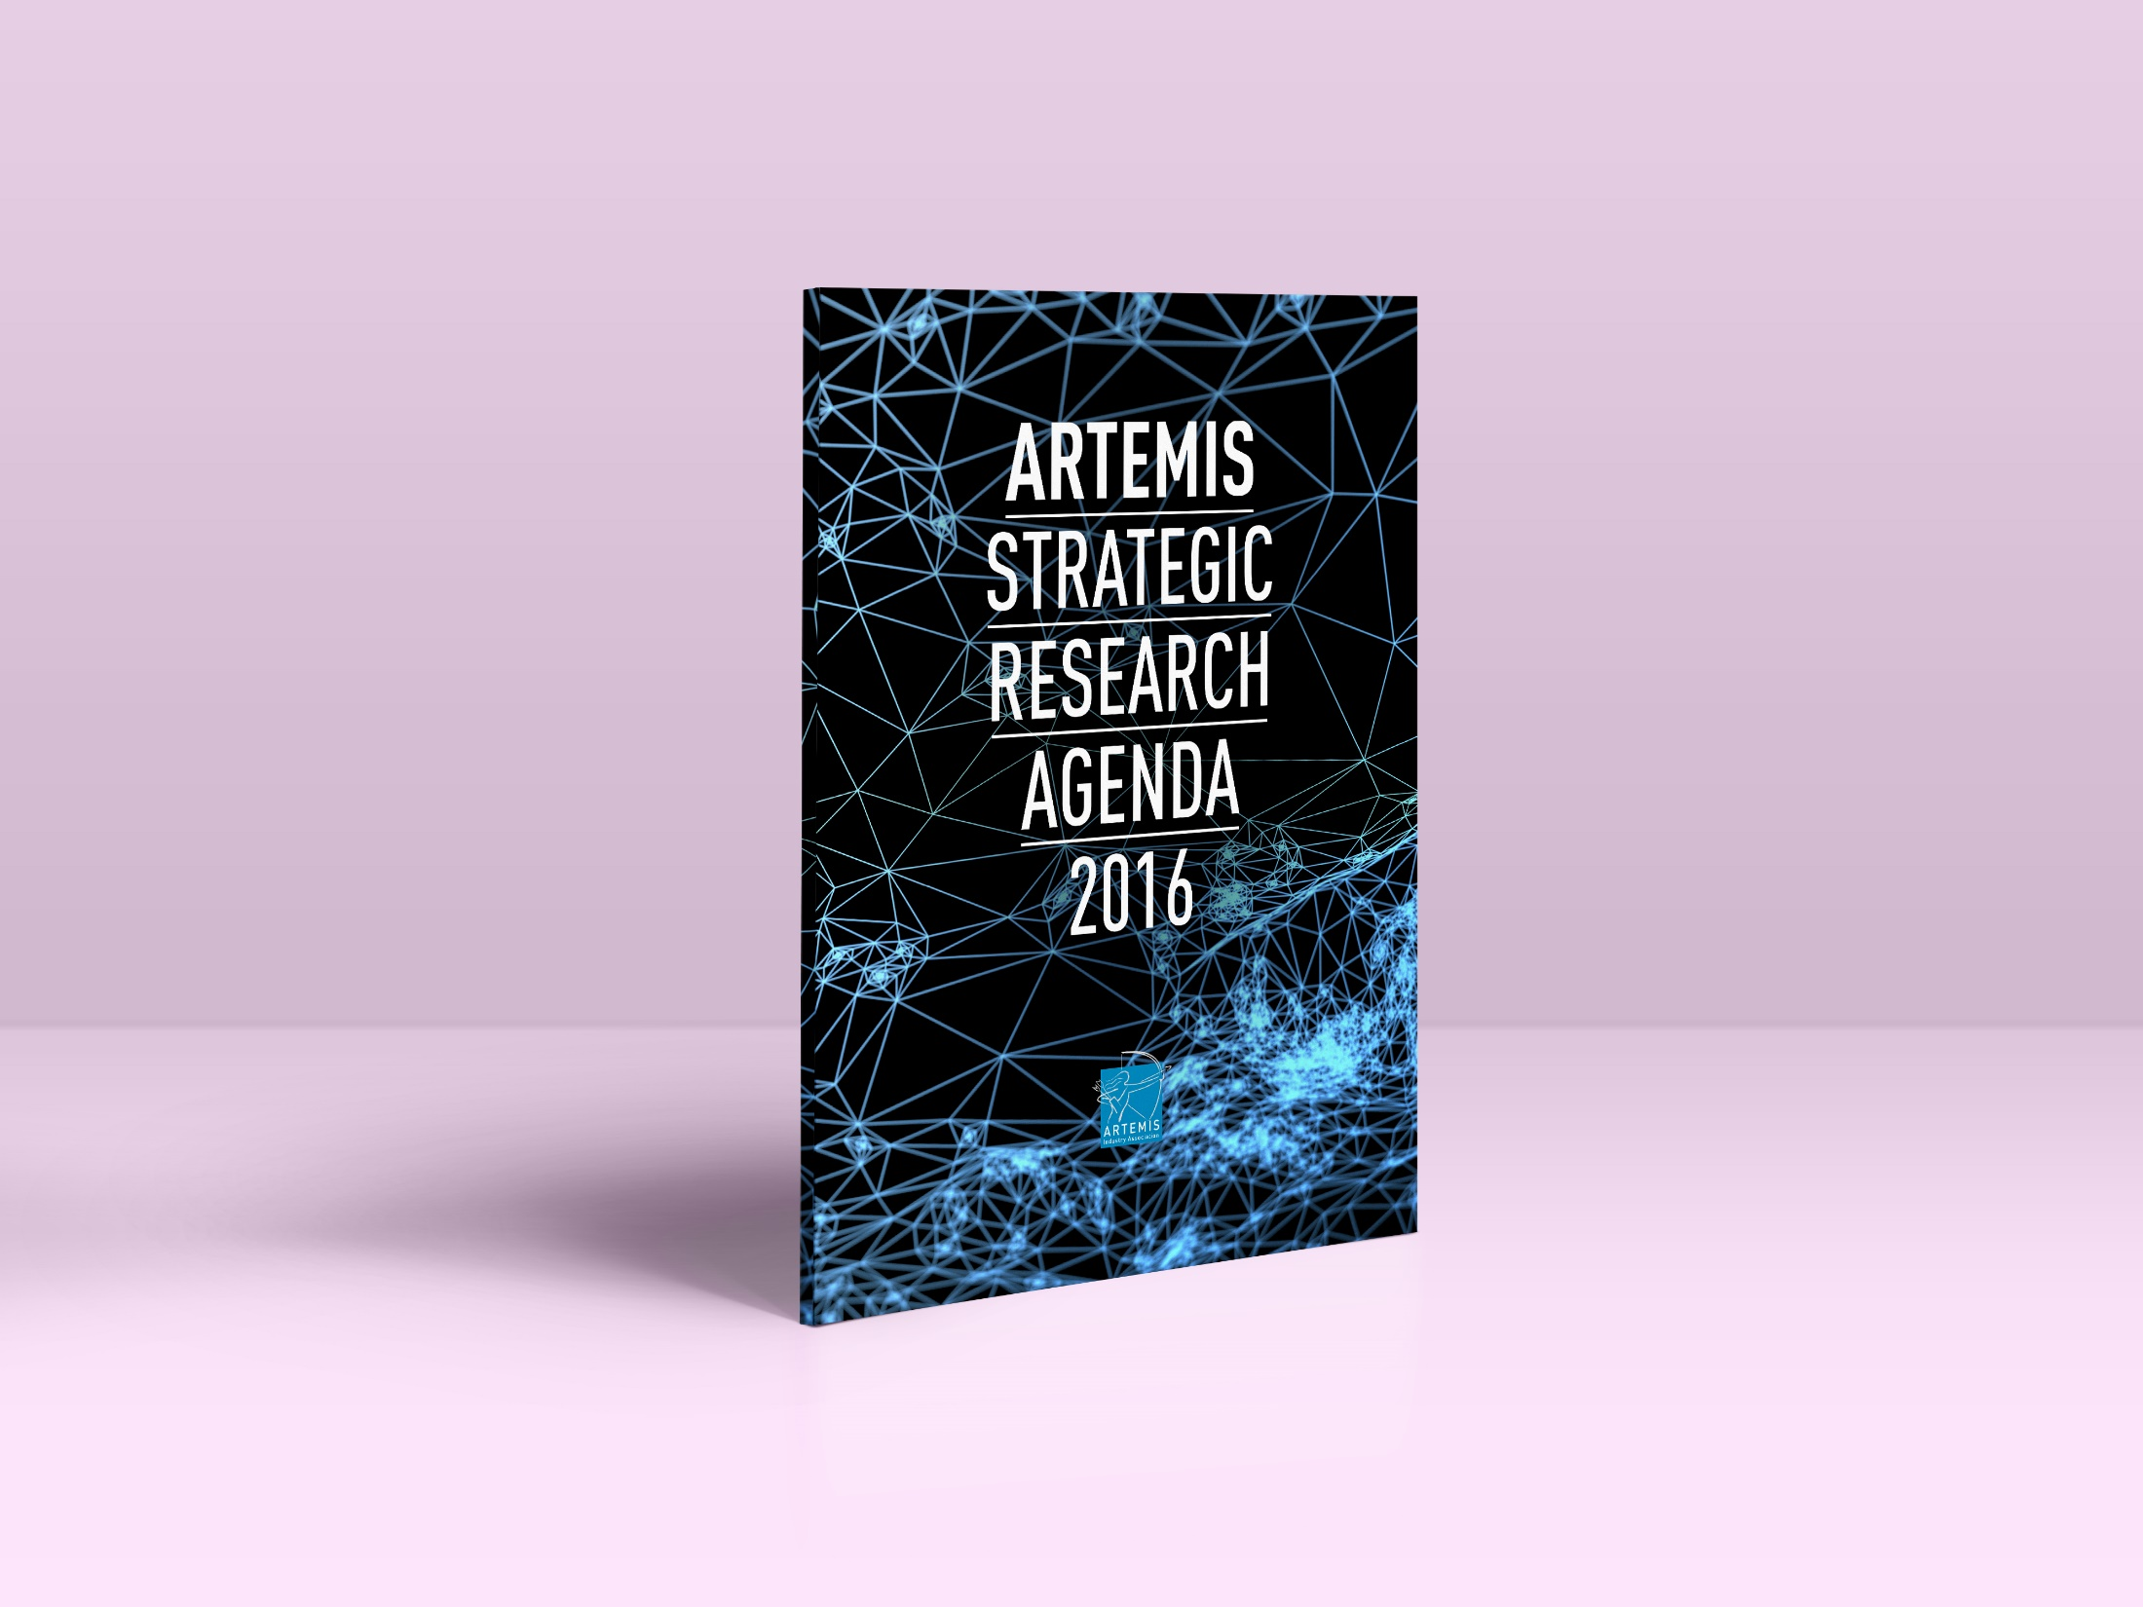

Slide 17
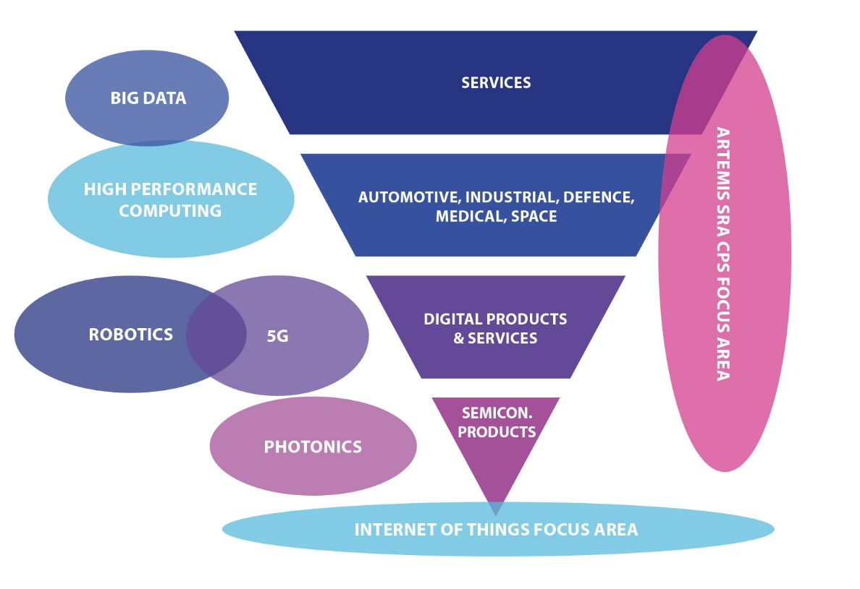
SRA 2016: Innovation Environment
Scale-up efforts by collaboration

Slide 18
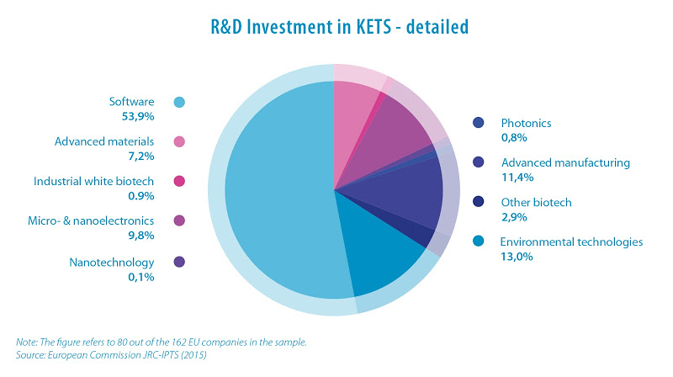

Slide 19

Embedded Intelligence
Impact on economy

Slide 20
Thank you

