Slide 1
Presenting ARTEMIS-IA Strategic Research Agenda 2016
ARTEMIS-IA Spring Event
Vienna, April 13th 2016
Laila Gide
Thales

Slide 2
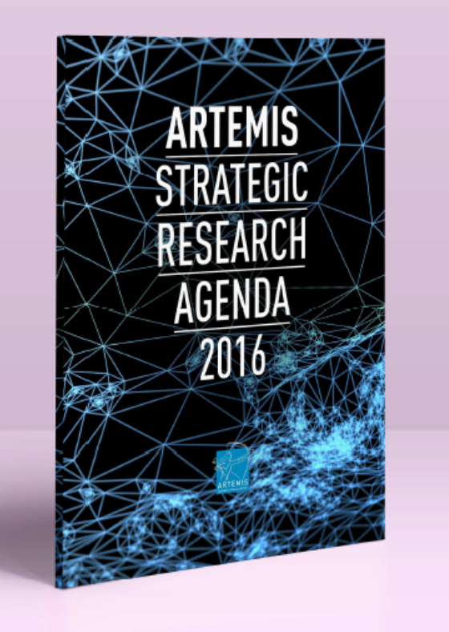
The Pathway to the Digital Transformation An Opportunity for Europe

Slide 3
Acknowledgement
ARTEMIS-IA gratefully acknowledges the contributions made by the following persons of the WG SRA Group of experts producing this SRA 2016:
Ronald Begeer
Ad ten Berg
Albert Cohen
Armando Colombo
Gerard Cristau
Werner Damm
Jerker Delsing
Marc Duranton
Christian EL Salloum
Sebastian Engell
Laila Gide
Radu Grosu
Matthijs Leeuw
Jürgen Niehaus
Stefano Pasquariello
Michael Paulweber
Erwin Schoitsch
Daniel Watzenig

Slide 4
The SRA content
1. Introduction
2. The new rationale: digital transformation
3. The ARTEMIS Vision , Ambition, and Main Objectives
4. The Digital Transformation in economic and societal challenges
5. ARTEMIS Innovation Strategy and Research Priorities
5.1 ARTEMIS Priority Targets
5.2 Innovation Strategy
5.3 Strategy Implementation
5.3.1 Cross domain Approach
5.3.2 Strategic Research Challenges
6. Innovation environment context – Make it Happen

Slide 5
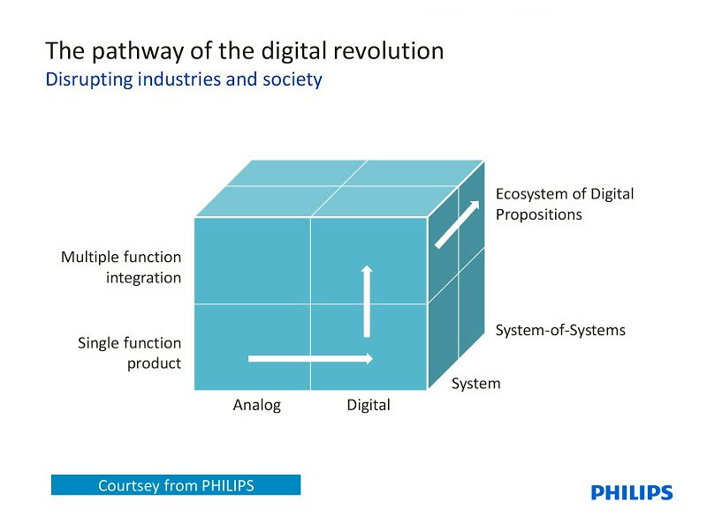
The SRA new rationale: digital transformation
The digital evolution, or digitisation, is a silent revolution that is transforming our way of living and of doing business.
Europe Future is Digital*
* an excerpt from Commissioner Oettinger speech at the Hannover Messe 2015.

Slide 6
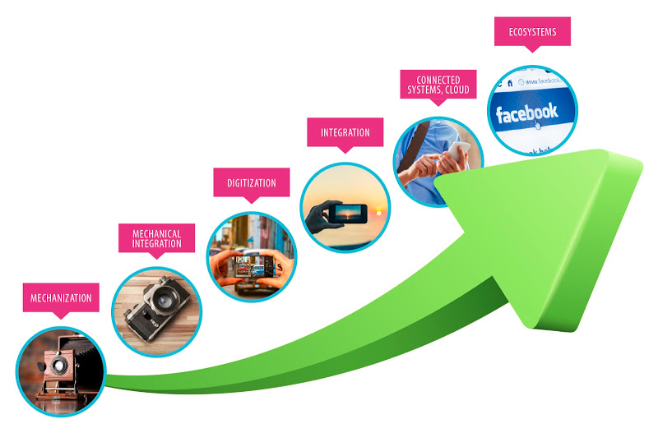
The SRA new rationale: digital transformation
The world is changing fast
The example of the evolution of photography
Cyber-Physical Systems are
key driver in the Digital Transformation
The main trends that will define the new era of Cyber-Physical Systems are:
The integration of functions across application contexts on large and open platforms, and
The combination with the Internet, its information and data, and its computing resources.

Slide 7
ARTEMIS Vision, Ambition and Main Objectives
Powered by the new era of the Digital Transformation ARTEMIS supports
A Vision where Europe remains among the world-class leaders in the area of Cyber-Physical Systems and Embedded Intelligence and position itself as a leader in digitisation for the benefit of the society and businesses in Europe and worldwide.
And an Ambition to play a major role in implementing the European Digital Single Market in European policy.

Slide 8
ARTEMIS Main Objectives
ARTEMIS Vision, Ambition and Main Objectives
ARTEMIS subscribes to the ‘Digital Single Market for Europe’ by providing strong technological capability over the total value chain.
Therefore ARTEMIS main objectives are to:
Consolidate the pathway of the digital revolution
Enable a more agile and shorter development cycle through the adoption of design by composition and correct-by construction principles.
Overcome fragmentation in the European supply base for the components and tools of design and engineering.
Remove barriers between application contexts to yield multi-domain, reusable components and systems.
Extend the use of digital platforms to build the eco-systems needed for accelerating the innovation and the creation of new business models.

Slide 9
The Digital Transformation Drivers
Leadership of vertically integrated companies
GAFA and others tend to extend their range from smart products to devices and even from silicon design to retail or Internet shops, while Samsung, Apple and IBM are moving into services
The “Always Connected Society”
the virtualisation of communities has changed our society and the way information and knowledge are exchanged, made available or shared.
The Platform concept and new hyper-scalability business models
Platform concept is cost efficient, provides facilities to experiment innovative products & services
Data value
Data deluge generated by the increasingly connected smart ‘Things’ and exchanged in an open-ended relationship
Security
Security considerations are essential as CPS are open and used in a networked environment.
The software value
a stronger software ecosystem is needed to nurture sustainable, interoperable CPS software development
Vulnerability, trust and privacy
By reaching the right level of safety and security while protecting the user’s privacy, CPS contribute in providing benefit to society in various application areas

Slide 10
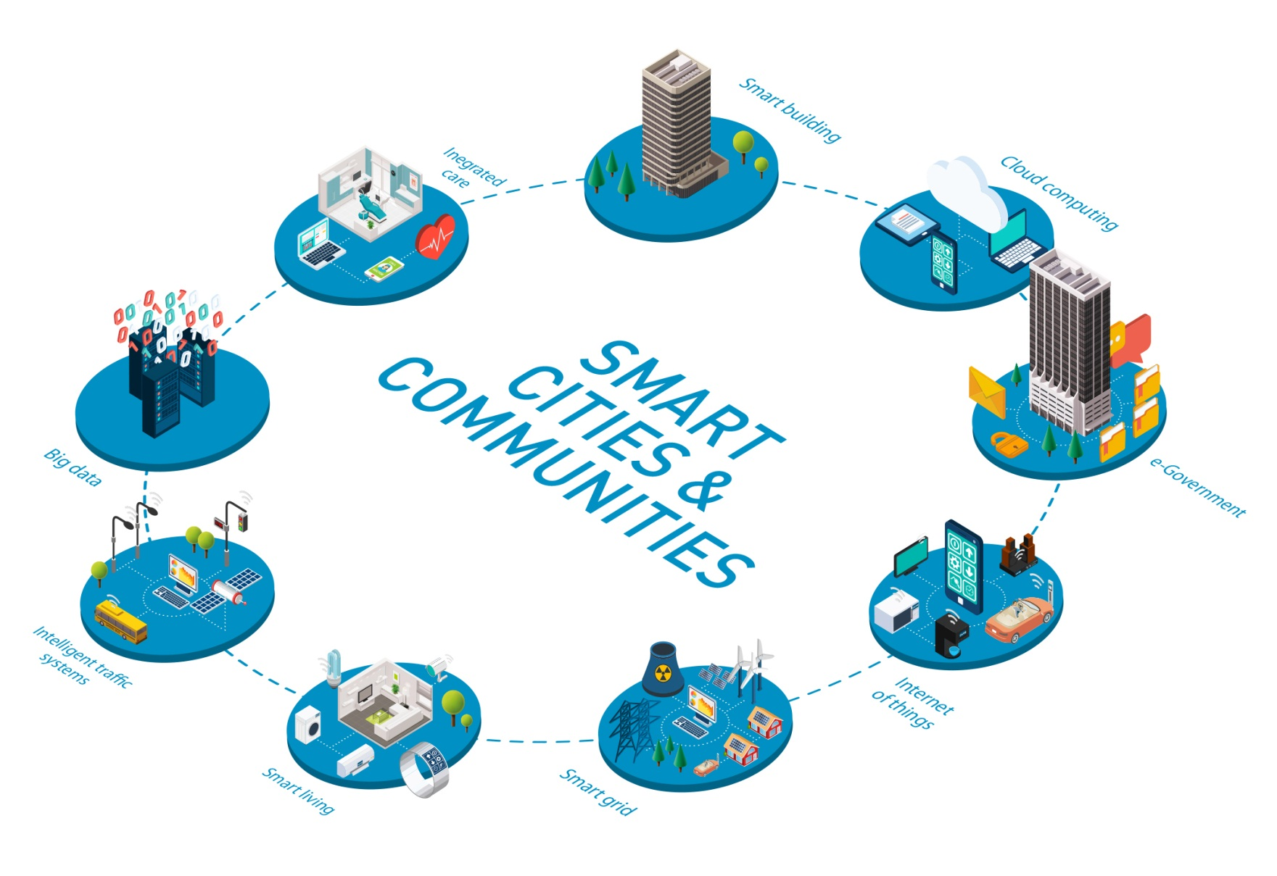
The Applications Drivers and Figures on Markets Trends and Opportunities
From IDC report
“Intelligent Systems are to exceed $1 Trillion in 2019 as the Market continues to disrupt traditional industries including manufacturing, energy, and transportation”.
The market for intelligent systems* will grow from 1.4 billion units and $755 billion in revenue this year (2014) to over 2.2 billion units and over $1 trillion in revenue by 2019.
From CyPhERS project
From 10 kilometres driven in 2004, today 400,000+ kilometres have been driven by Google’s autonomous cars.
Potential market is 1 billion trucks and cars, globally, with 450,000 civilian, military and general aviation aircraft.
Sales of industrial robots grow by 170% every two years, with 12% of the global workforce of 320 million units in manufacturing being executed by robots
They are just examples and do not cover all the potential applications such as smart energy, smart food, smart farming and agricultural, smart wearables, and many more.
The application drivers developed in the SRA are
Smart Mobility
Sustainable Production
Smart Health and Wellbeing
Smart City
*defined by microprocessors, connectivity, and high-level operating systems/UI in systems excluding PCs, phones, servers, and tablets

Slide 11
ARTEMIS Innovation Strategy and Research Priorities
ARTEMIS Priority Targets
With the purpose of having greater impact and quick-to-markets results and to guide the R&D programmes the following priority targets are selected:
product-family roll-out governed by business needs (rather than engineering limitations)
faster to market: reduce the development cycle, and development costs by: Shorten the time to market and Mastering the complexity
Increased efficiency: easy adoption by the users and lowering the threshold of product introduction in face of rapidly changing market needs better pervasive/ adoption
Improved sustainability: by enhancing product and system ease of use, adopting multi-view system design (from conception to operation and services) as well as a reuse policy.

Slide 12
ARTEMIS Innovation Strategy and Research Priorities
Innovation strategy : The concept
There is a change from static networked Cyber-Physical Systems to Systems-of-Systems and Cyber-Physical Systems technology should no longer be considered in isolated application contexts
ARTEMIS innovation strategy developed in the previous SRA is two-pronged:
one is to ‘Build on the leading positions where Europe is strong’
And the other to ‘Create new opportunities’ for Europe to be positioned at the forefront of new or emerging markets with high potential growth rates
The new strategy is more user-centric
To take into account the user’s benefit and experience, over the whole value chain
By building better and more efficient technological solutions

Slide 13
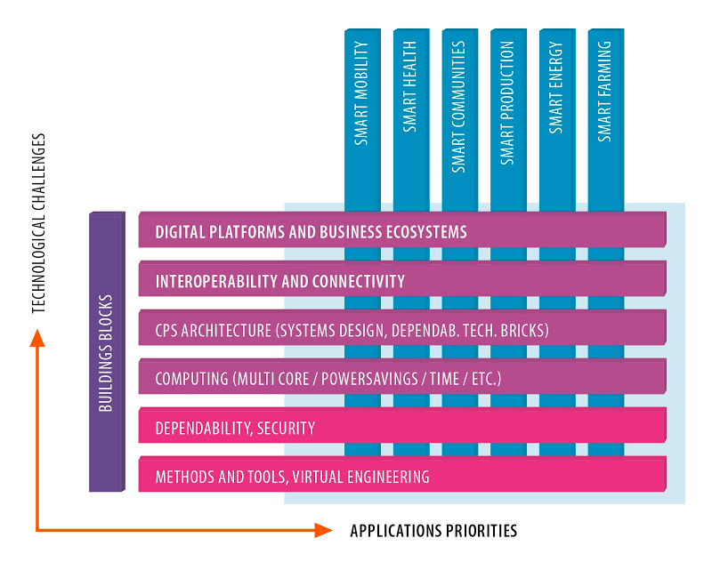
Strategy implementation : The Cross-domain approach
ARTEMIS Innovation Strategy and Research Priorities
To share communalities and synergies to overcome the fragmentation and create critical mass for the investments and to embrace the technology challenges

Slide 14
ARTEMIS Innovation Strategy and Research Priorities
Strategic Research challenges: the Building Blocks Approach
In order to break domain barriers and boost innovation, research activities should continue to foster the cross-domain approach and seek greater synergies to develop common building blocks.

Slide 15
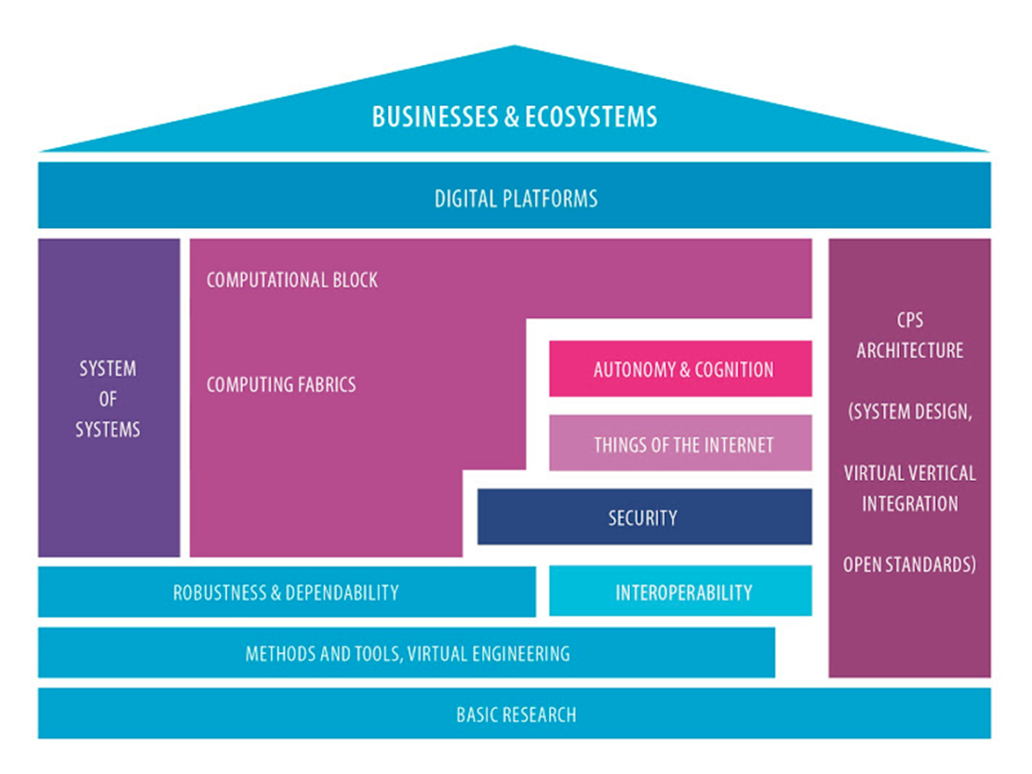
ARTEMIS Innovation Strategy and Research Priorities
Strategic Research challenges: the Building Blocks Approach
Building such predictable CPS components is needed to maximise the reuse, accelerate the development cycle and, consequently, time to market.
New core elements and development and validation technologies are needed for the development of smart, connected and highly automated smart products

Slide 16
ARTEMIS Innovation Strategy and Research Priorities
A highly dynamic approach for better
Digital Transformation Sustainability

Slide 17
ARTEMIS Innovation Strategy and Research Priorities
Strategic Research Priorities
CPS Architectures Principles
Design Methods, Tools, Virtual Engineering
Trust, security, Robustness and Dependability
Autonomous and Robotic Systems and Cooperation
Seamless Connectivity and Interoperability
Cyber-Physical System of Systems
Computational Blocks
Digital Platforms
Basic Research, fundamental Research

Slide 18
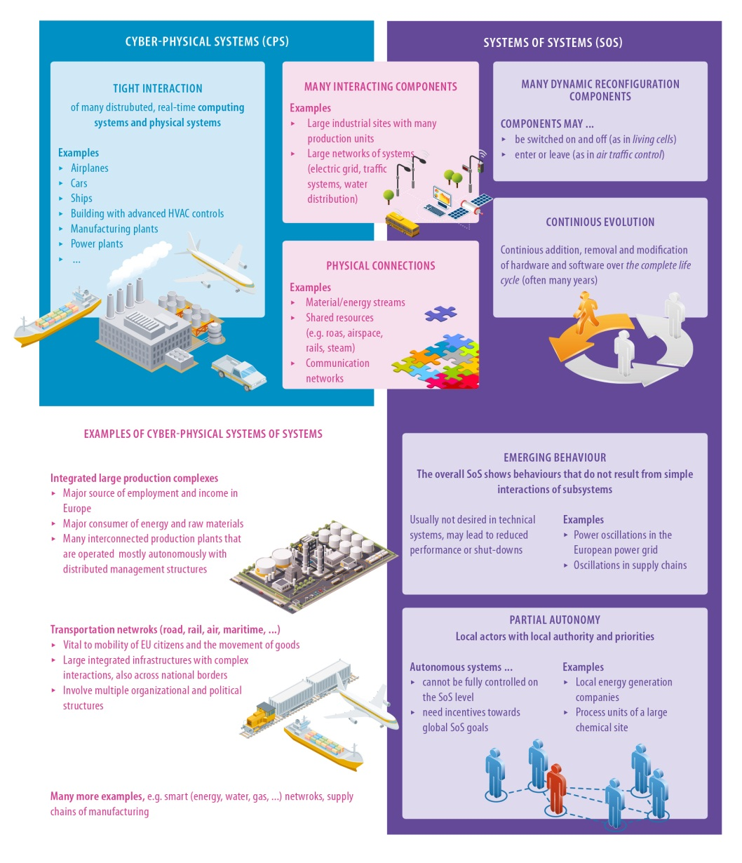
ARTEMIS Innovation Strategy and Research Priorities
An extract from Cyber-Physical System of Systems

Slide 19
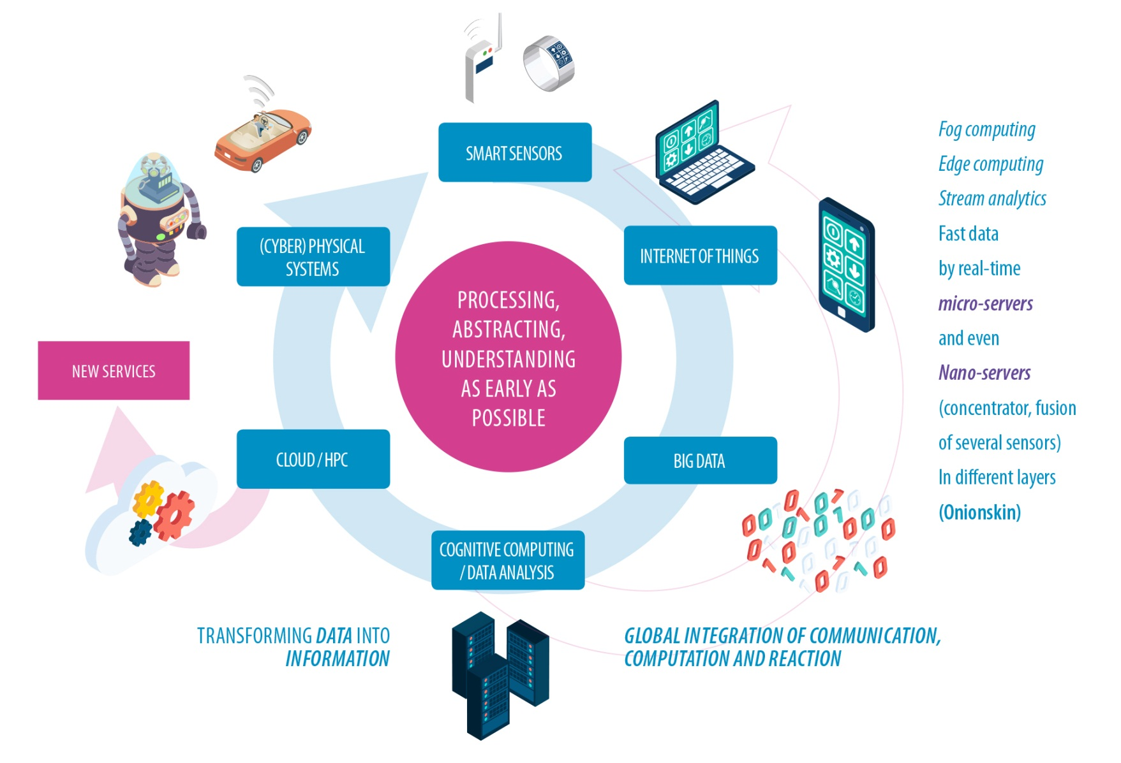
ARTEMIS Innovation Strategy and Research Priorities
An extract from : Computational Blocks

Slide 20
ARTEMIS Innovation Strategy and Research Priorities
The importance of conducting Basic Research/foundational research
In the SRA chapters ( 5.3.2.1 to 5.3.2.8), the research challenges depicted cover a range from low to high maturity, and thus in a way address some basic research for the extension of such research to the scientific foundations which are key for sustaining a European leading position in this domain.
CPS research areas span various maturity levels, and some are still lacking the appropriate level of the established engineering and scientific disciplines that make it possible to predict the properties of the constructed systems from their blueprints. To address these concerns, we consider imperative to:
Develop techniques making CPS predictable and dependable across their whole lifecycle;
Capitalise on synergies in building CPS, driving open, horizontal and vertical standards;
Develop open platforms and living labs for testing and experimentation with CPS;
Develop and exchange best practices for training and education for CPS.

Slide 21
Innovation environment context – Make it Happen
ARTEMIS-IA Innovation
ARTEMIS-IA Innovation aims to foster the Digital Transformation by supporting the development of innovative smart products, services and solutions in a large variety of activity sectors for the benefit of the users, citizens and businesses
ARTEMIS-IA will maintain its initial differentiators and will further build on:
Being an ‘Industry driven’ initiative,
Sustaining its focus on both business competitiveness and technical excellence,
A descriptive ‘Top-down’ approach based on a Strategic Agenda, supported by a bottom-up expression of needs through its Centres of Innovation Excellence ( CoIE) and its constituency,
Keeping the focus on impactful and market-oriented projects, such as large-scale projects, flagships or lighthouses;
Having a coherent projects portfolio built on large footprint projects with support from smaller focused projects, while ensuring the balance between different research actors (large, mid and small industry as well as RTOs and Academic) to drive innovation,
Actively supporting the creation of innovation eco-systems,
Openness and complementarities with EU framework programmes, Eureka particularly ITEA, and the EIT KICs for getting research results to market.
Fostering the synergies and relation with the other European initiatives, namely the European Technology Platforms ( ETP), Public Private Partnerships (PPP) and Joint Undertaking JU.

Slide 22
Innovation environment context – Make it Happen
Research Funding Programmes
To ‘Make it Happen’ ARTEMIS Industry Association’s ambition is to inspire a wide range of the research policymakers in Europe and their work programmes, mainly:
the EC Research Framework Programmes (such as H2020 2014-2020),
the ECSEL JU work programmes
the multi-national Eureka clusters ITEA3 and PENTA programmes,
National and Regional research programmes
Efficient use of Public available funding in the Cyber-Physical Systems arena will help overcome the resource deficit for R&D and to foster innovation & collaboration in Europe,

Slide 23
Innovation environment context – Make it Happen
Centres of Innovation Excellence
ARTEMIS developed the of Centres of Innovation Excellence (CoIEs) concept and focused on a small number of systems-oriented CoIEs of a multi-disciplinary nature
Several initiatives have already been launched such as EICOSE, Finnish SCSTIs, ProcessIT.eu or SafeTrans.
ARTEMIS-IA will continue to cooperate and build on these existing CoIE and extend it to cooperate with regional clusters such as Pôle de Compétitivité in France, Pôle de Compétitivité “Point One” in the Netherlands, Kompetenz-Netze in Germany…
CoIE will contribute to ARTEMIS-IA by, e.g. :
feeding domain-oriented requirements into the ARTEMIS Strategic Research Agenda via structured, domain-specific think-tanks;
mobilising a critical mass at European level for driving a significant part of an application domain of the SRA;
establishing integration platforms, living labs and test-beds

Slide 24
Innovation environment context – Make it Happen
Standards and Standardisation
Standardisation is important for exploiting the results of research projects
New topics, like IoT, Cloud Computing, Automated Vehicles (Driving), Autonomous Systems, Robotics etc. have taken up standardisation as a mandatory need in their context.
Without stringent standardisation it will not be possible to make things happen such as the interoperability of components and systems, and of tools and data, and communication in a connected world of “things”, complex systems-of-systems, like IoT or “connected autonomous vehicles”,
Cyber-Physical Systems-of-Systems (CPSoS) require multi-concern assurance for qualification or certification. The dependability properties have to be assured via co-analysis and developed via co-engineering methodologies, which again requires research results to be brought to standards or integrated into standards
ARTEMIS require that RD&I projects communicate with relevant ARTEMIS-IA standardisation initiatives concerning their standardisation needs and opportunities, including those that may emerge during project execution.

Slide 25
Innovation environment context – Make it Happen
An example of Standards impact

Slide 26
Innovation environment context – Make it Happen
Education and Training
The new global Digital Economy needs and its high growth rate faces the “largest human capital shortage in the world”
Effective education and training is crucial to maintain competitive leadership as a pre-condition for “sustainable innovation ecosystem”.
The Strategic Research Agenda recommends:
Make “education and training” output part of projects’ deliverables
Foster life-long continuous learning to create a highly skilled, multi-disciplinary workforce, and maintain and upgrade the existing skills designed to overcome the gap between theory and practice of (industrial) application;
Establish new types of people mobility programmes with an industrial focus,
Support high-tech spin-offs and start-up companies by facilitating non-technical training in entrepreneurship, finance and business practice, etc…;
Influence pan-European policies to achieve long-term effects in Embedded Systems education and training,
Provide adequate university and applied university curricula in Embedded Intelligent Systems domains,
Foster the cooperation with the EIT KIC Digital in this topic.

Slide 27
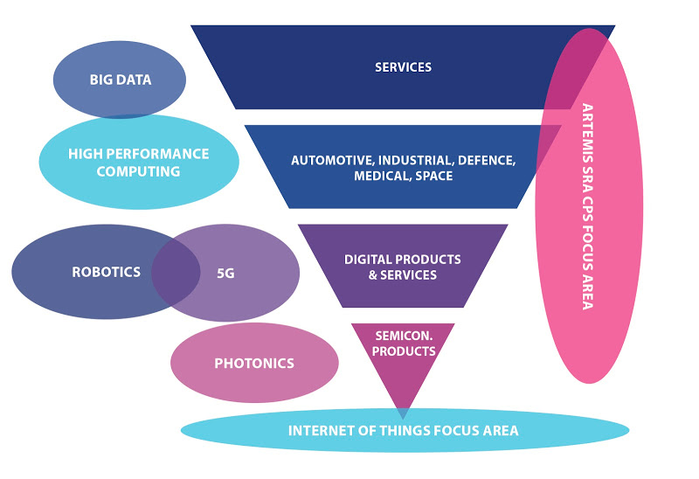
Innovation environment context – Make it Happen
Relationship with other relevant initiatives and PPPs
ARTEMIS SRA focus area is cross-cutting to all as the embedded software development, software-based services and the Cyber-Physical Systems technologies, constitutes an indispensable enabler

Slide 28
Innovation environment context – Make it Happen
International Dimension
Research and innovation are becoming global, ignoring frontiers and being performed where the creative individuals and eco-systems exist. The race is now about being ‘best in the world’ or the ‘world of the best’
ARTEMIS-IA will define “modalities” for interaction between the European R&D community and the main international players in Embedded Systems and ICT, Cyber-Physical Systems and Cyber-Physical-Systems-of-Systems, areas including:
Research institutions, professional organisations
(ACM, IEEE, ARC Advisory Group, IFAC, IFIP),
standardisation bodies (e.g.: OMG, IEEE, IEC, ISO/ISA),
large consortia (e.g., the Industrial Internet Consortium, the Cyber-Physical Systems Public Working Group the Smart Manufacturing Leadership Consortium
funding agencies (e.g.: IST, NSF, DARPA, NSERC, ARC)
In particular, ARTEMIS-IA will foster the cooperation with the IEEE Industrial Electronics Society (IES) and “Industrial Cyber-Physical Systems” technical committee

Slide 29
Conclusions: the Way Ahead
ARTEMIS has proven to be a unique ‘initiative’ that in just a few years succeeded in establishing the largest R&D&I projects ever in the area of Embedded Intelligent Systems
The renewed vision and strategy aims to pursue this strategy in order to accomplish the ARTEMIS ambition and position it as a world-class initiative in the area of Cyber-Physical Systems
The emerging Digital evolution relies heavily on Embedded Intelligent Systems technologies in domains where it is paramount that Europe takes a leadership role. Our renewed Vision and Strategy aims to follow this path in order to accomplish the ARTEMIS ambition and become a world-class initiative in the Embedded Intelligence and Cyber-Physical Systems
We need increased investments to support our Research Agenda and to sustain our proposition of an ‘lnnovation Environment’ allowing high value creation in the new generations of smart products and services.
Giving the right economic visibility of Embedded Intelligence is of utmost importance to the European Industry for the Digital Future of Europe.

Slide 30
Thank you

